Slide 1
NLP PROJECT
ON
RESTAURANT REVIEW SYSTEM
BY:
JIVESH PODDAR (16BIT020)

Slide 2
INTRODUCTION
Opening and managing a restaurant at any place is a difficult business. According to Business Insider, as many as 60% of restaurants close within the 1st year of opening. This is a great source of positive and negative feedback from customers. However, there are some issues:
It is time consuming to read all reviews. Even if a customer decides to read all reviews,That still would not allow him/her to compare feedback against the restaurant.
.

Slide 3
INTRODUCTION
The purpose of this analysis is to build a prediction model to predict whether a review on the restaurant is positive or negative. To do so, we will work on Restaurant Review dataset, we will load it into Predictive algorithms.
The Goal will be achieved using 2 Techniques.
PREDICTION USING NAIVE BAYES
PREDICTION USING LOGISTIC REGRESSION
AND LATER THEIR RESULTS WILL BE COMPARED.

Slide 4
MOTIVATION
This project aims to analyze restaurant reviews on via topic modeling to determine main topics for positive and negative reviews. Once each review was assigned its topic weights, that information was averaged to assign overall review for that restaurant.
With all restaurant reviews translated into a topic space, direct comparison of positive and negative review topics was made possible.

Slide 5
NEW THINGS THAT WE WILL LEARN
New algorithm and strategies. Such as Text Analysis Algorithms using NLTK (Natural Language ToolKit) which includes - Tokenization , Removing Stopwords , Lexicon Normalization , Stemming , Lemmatization , POS Tagging , Classifiers.
NLP helps us to understand how machines learn to communicate with each other and with humans in a meaningful way. Working on Combination of Literature and NLP

Slide 6
DATASET DESCRIPTION
A simple project in python which reads a tsv file, cleans the restaurant reviews(text), generates a bag-of-words model and uses a classifier which tells whether the review is a positive one or a negative one
Description of the dataset to be used:
Columns seperated by \t (tab space)
First column is about reviews of people
In second column, 0 is for negative review and 1 is for positive review

Slide 7
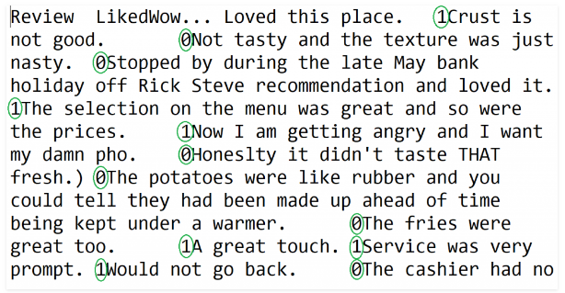

Slide 8
BLOCK DIAGRAM
Text Pre-processing
Tokenization
# Importing the libraries
import numpy as np
import matplotlib.pyplot as plt
import pandas as pd
# Importing the dataset
dataset=pd.read_csv('Restaurant_Reviews.tsv', delimiter = '\t',quoting = 3)
Removing stopwords &Stemming
Lemmantization
Classification into one of the part of speech
TRAINING AND TESTING

Slide 9
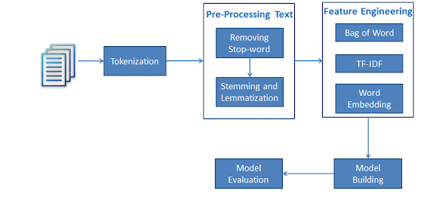

Slide 10
IMPLEMENTATION
Firstly the data is preprocessed , i.e. reviews are combined put in same format and punctuation marks are removed.
Then based upon the techniques of POS tagging , Stemming and Lemmantization we extract the meaningful words out of the sentence.
Then we find out the Part of Speech used.
Then the Data is Trained through the 2 approaches after Fitting.
10% of the training reviews are separated for testing.
Test Results are Obtained after training and Confusion Matrix is calculated.
Accuracy , Precision and Recall is also calculated.

Slide 11
NLP LIBRARIES USED
# Importing the libraries
import numpy as np
import pandas as pd
# Importing the dataset
#Tokenization
from nltk.tokenize import sent_tokenize, word_tokenize
# Cleaning the texts
import re
import nltk
from nltk.corpus import stopwords
from nltk import FreqDist
#STEMMING
from nltk.stem.porter import PorterStemmer
#LEMMATIZATION: LEXICON NORMALIZATION
from nltk.stem.wordnet import WordNetLemmatizer
#POS TAGGING

Slide 12
SOURCE CODE
# Fitting Naive Bayes to the Training set
from sklearn.naive_bayes import GaussianNB
classifier = GaussianNB()
classifier.fit(X_train, y_train)
# Fitting Logistic Regression to the Training set
from sklearn import linear_model
classifier = linear_model.LogisticRegression(C=1.5)
classifier.fit(X_train, y_train)
# Splitting the dataset into the Training set and Test set
from sklearn.model_selection import train_test_split
X_train, X_test, y_train, y_test = train_test_split(X, y, test_size = 0.10, random_state = 0)

Slide 13
RESULTS
AFTER POS TAGGING
Liked Wow... Loved this place. 1
Total words left is : 3 out of 6
Lemmatized words are : wow
Lemmatized words are : love
Lemmatized words are : place
[('wow', 'NNS'), ('love', 'VBP'), ('place', 'NN')]
AFTER POS TAGGING
Crust is not good. 0
Total words left is : 2 out of 4
Lemmatized words are : crust
Lemmatized words are : good
[('crust', 'NN'), ('good', 'NN')]

Slide 14
RESULTS using NAIVE BAYES
# Predicting the Test set results
y_pred = classifier.predict(X_test)
print(y_pred)
[ 1 1 1 0 0 1 1 1 1 1 1 1 1 1 1 1 0 0 0 1 0 0 1 1 1 0 1 1 1 0 1 1 1 1 1 0 1 0 1 1 1 1 1 0 1 0 1 1 0 0 1 1 1 1 0 0 1 1 0 1 1 0 1 1 1 0 1 1 1 1 1 1 1 1 0 1 1 0 0 1 0 1 1 0 1 1 0 0 1 1 0 1 0 0 1 1 1 1 1 1 ]
Accuracy is 73.00 %
Precision is 0.78
Recall is 0.77
# Making the Confusion Matrix
from sklearn.metrics import confusion_matrix
cm = confusion_matrix(y_test, y_pred)
print(cm)
Confusion Matrix:
[[ 27 24]
[ 3 46 ]]

Slide 15
RESULTS using LOGISTIC REGRESSION
# Predicting the Test set results
y_pred = classifier.predict(X_test)
print(y_pred)
[ 0 0 0 0 0 0 1 0 0 1 1 1 1 1 1 1 0 0 0 1 0 0 1 1 1 1 1 1 1 1 1 1 1 0 1 0 0 0 0 1 1 1 1 0 0 0 1 1 1 0 1 1 1 1 1 0 0 0 0 1 0 0 0 1 0 0 1 0 0 0 1 1 0 0 0 0 0 1 0 1 1 1 1 0 1 1 0 0 1 1 0 1 0 0 0 0 0 0 0 1 ]
Accuracy is 74.00 %
Precision is 0.78
Recall is 0.77
# Making the Confusion Matrix
from sklearn.metrics import confusion_matrix
cm = confusion_matrix(y_test, y_pred)
print ("Confusion Matrix:\n",cm)
Confusion Matrix:
[[38 13]
[13 36]]

Slide 16
CONCLUSION & FUTURE WORK
This research presented a novel approach on distinguishing the food dishes served at a restaurant by classifying the reviews based on the previous customer reviews.
This research is primarily focused on analysing a restaurant reviews, but by Increasing the scope of the restaurants , to some other domain specific dictionary, a similar approach can be applied to future studies as well.

Slide 17
SOCIAL APPLICATION
---->>”Using Machine Learning and Natural Language Processing techniques, we can distinguish the best dishes served at a restaurant from the bad ones”
---->> ”Using Machine Learning and Natural Language Processing techniques, we can choose whether to visit that restaurant or not”
---->> Overall genre of the restaurant can be predicted.

Slide 18
REFERENCES
http://spacab.com/wp/using-python-to-perform-lexical-analysis-on-a-short-story
https://www.datacamp.com/community/tutorials/text-analytics-beginners-nltk
https://www.nltk.org/book/ch08.html

Slide 19
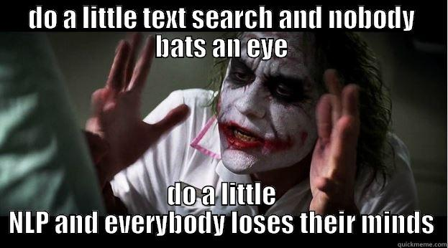

Slide 20


